Slide 1
Understanding Dutch Beer-Drinking behavior
Between weather, price and unemployment, what has the most notable influence?

Slide 2
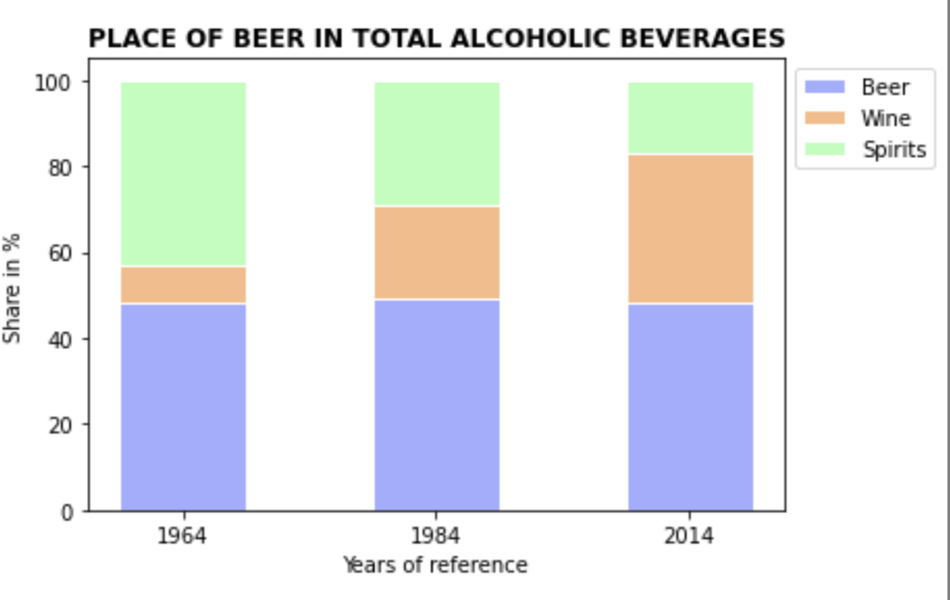
Share of Beer consumption in alcoholic beverages
‘...Biertje?...’

Slide 3
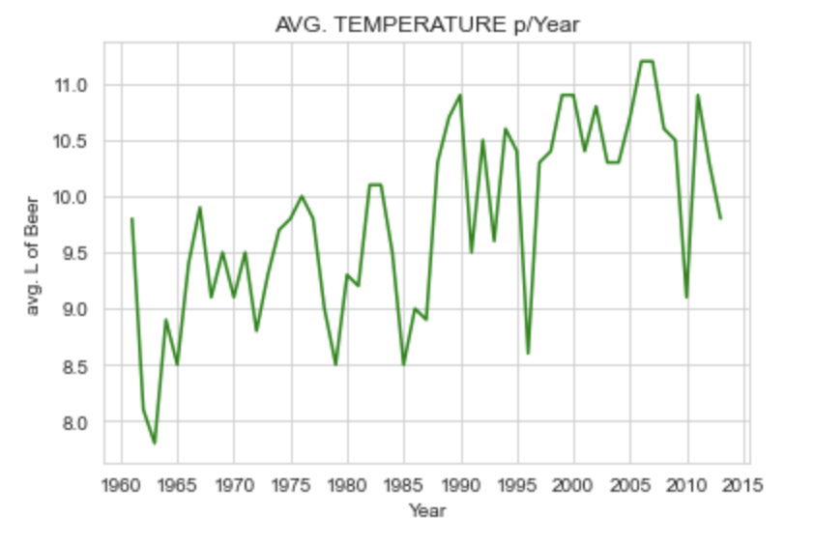
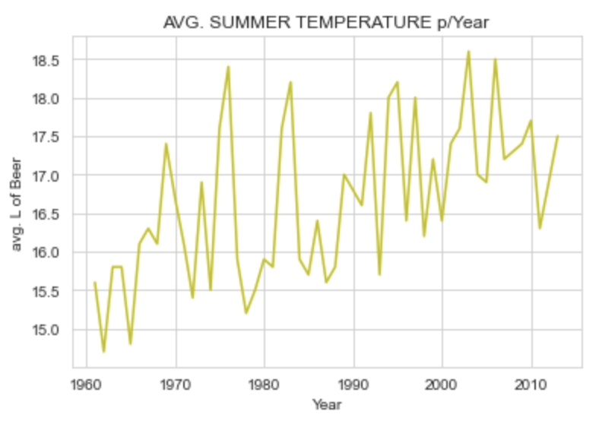
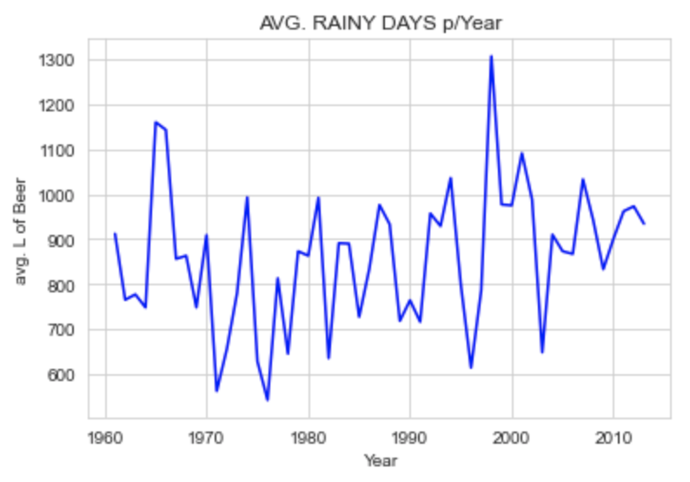
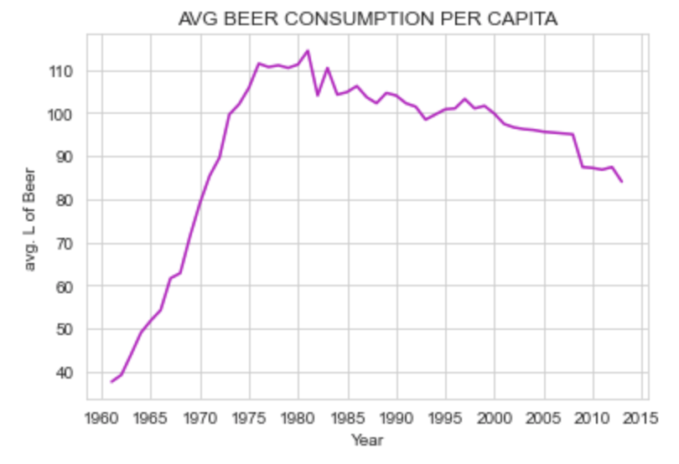
Beer Consumption vs. Weather
Parapluutje, parasolletje…

Slide 4
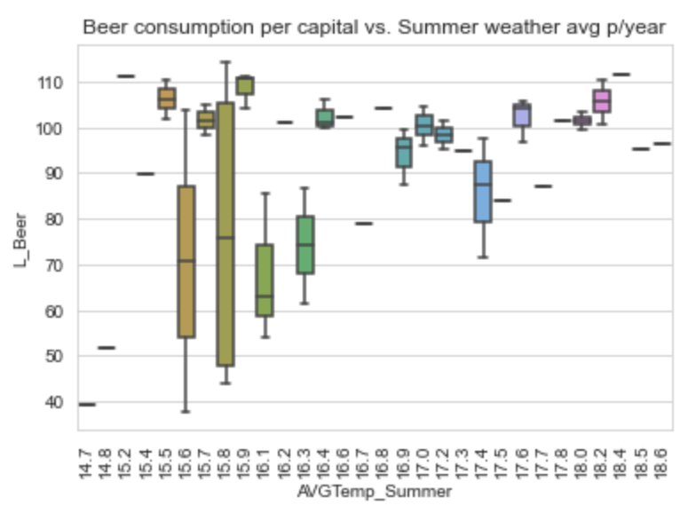

Slide 5
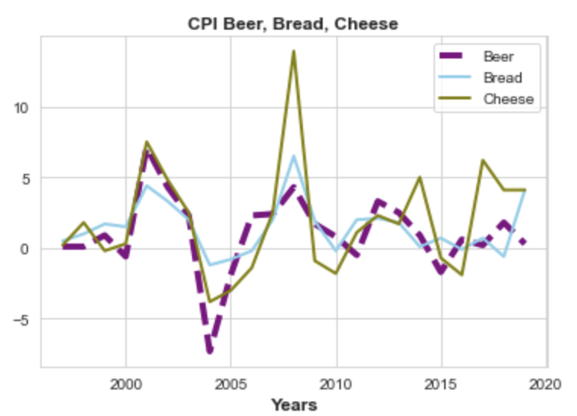
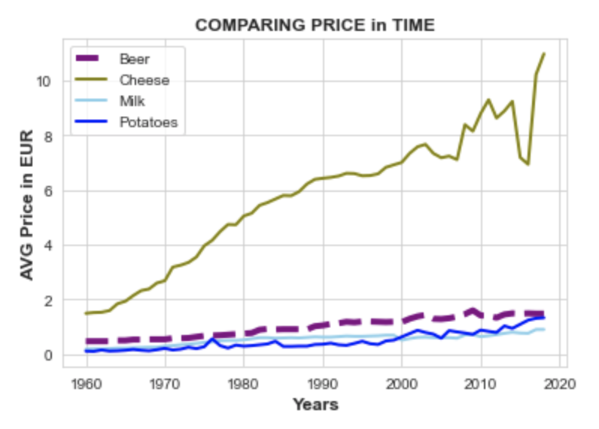
Beer consumption vs. Price of Beer
‘...Het geld groeit niet op mijn rug…’

Slide 6
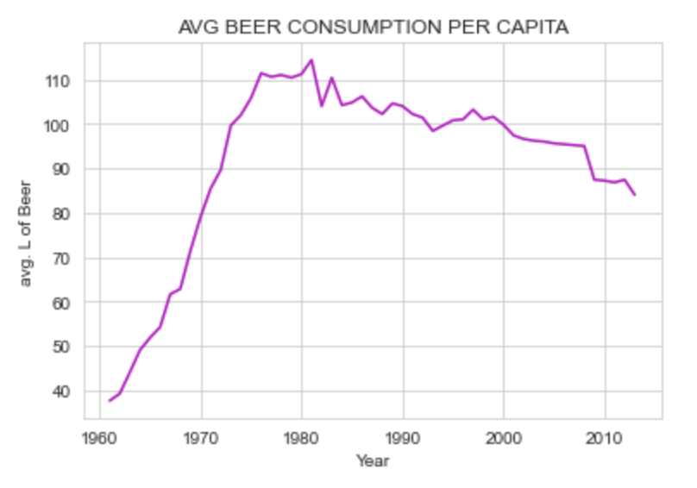
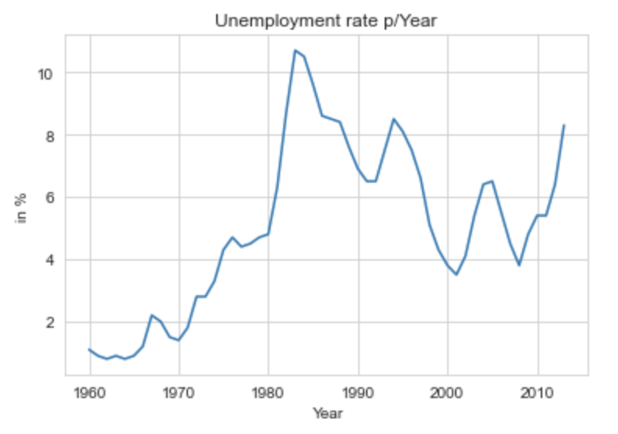
Beer consumption vs. Unemployment
‘...Hij lijdt aan natte armoede…’

Slide 7
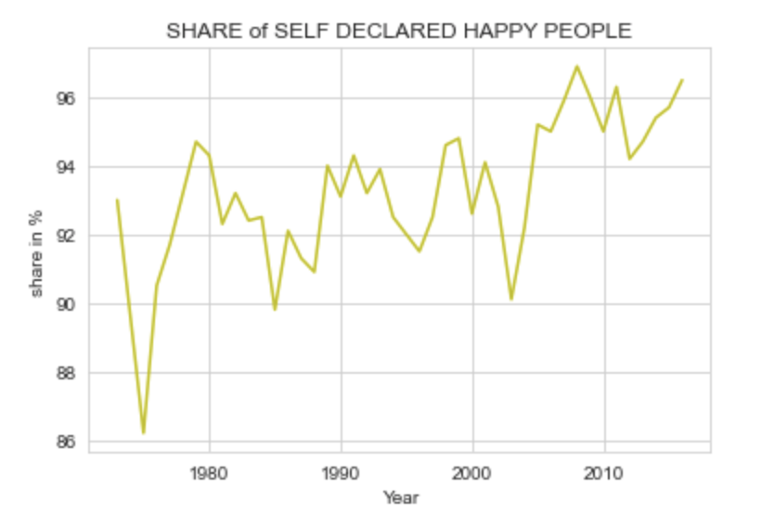
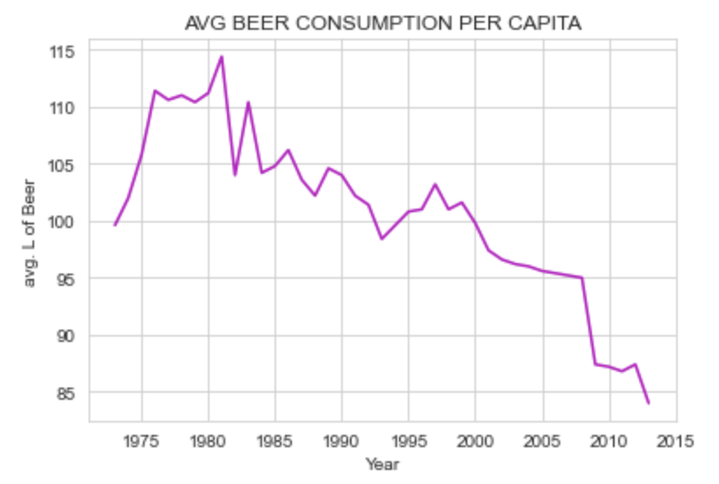
Beer consumption vs. Self-declared happiness
‘... ‘Wanneer het bier is in de man, dan is de wijsheid in de kan…’

Slide 8
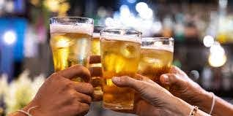
Biertje?

